Slide 1


HOTEL RESERVATION ANALYSIS USING
SQL
PRESENTED BY: ANKITA DEY

Slide 2




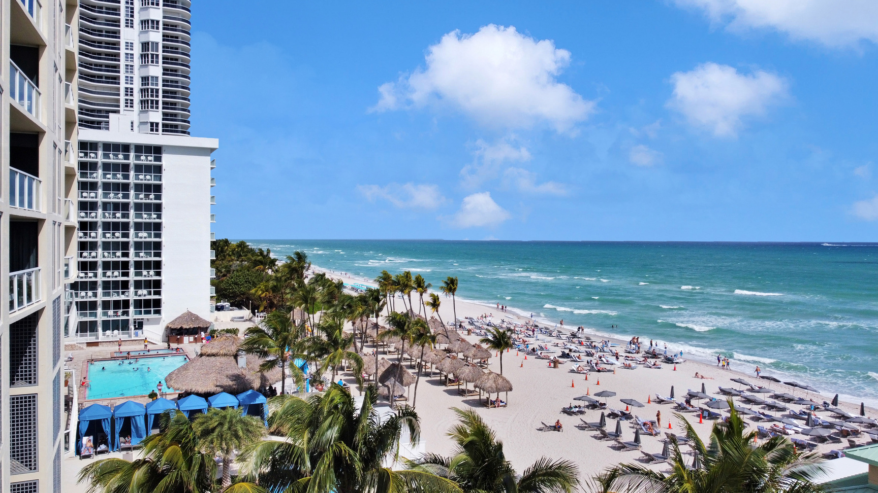
Content
Overview
Goals & Objectives
The Project
Dataset Details
Project Details
Overall insights
Conclusion

Slide 3



OVERVIEW
In today's hospitality industry, using data effectively is essential for hotels that want to provide excellent guest experiences and improve their operations. Analyzing hotel reservations using SQL is a powerful way for hotels to find valuable insights from their booking records.

Slide 4
Goals & Objectives
The objective of hotel reservation analysis is to extract meaningful insights from reservation data that can inform and optimize various aspects of hotel operations and guest experiences. Specifically, the goals include:
Guest
Preferences
Optimizing
Revenue
Management
Forecasting
and
Planning
Enhancing
Marketing
Strategies
Understanding Booking Patterns
Operational
Efficiency

Slide 5

THE PROJECT
The project on hotel reservation analysis aims to utilize SQL to analyze a comprehensive dataset of hotel reservations. By utilizing SQL queries, the project aims to uncover meaningful insights into guest booking behaviours, preferences for room types as well as trends in booking patterns throughout different seasons and days of the week.

Slide 6

Dataset Details
The dataset includes the following columns:
Booking_ID: A unique identifier for each hotel reservation.
no_of_adults: The number of adults in the reservation.
no_of_children: The number of children in the reservation.
no_of_weekend_nights: The number of nights in the reservation that fall on weekends.
no_of_week_nights: The number of nights in the reservation that fall on weekdays.
type_of_meal_plan: The meal plan chosen by the guests.
room_type_reserved: The type of room reserved by the guests.
lead_time: The number of days between booking and arrival.
arrival_date: The date of arrival.
market_segment_type: The market segment to which the reservation belongs.
avg_price_per_room: The average price per room in the reservation.
booking_status: The status of the booking.

Slide 7

PROJECT DETAILS

Slide 8


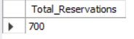
Query 1: What is the total number of reservations in the dataset?
select count(*) as Total_Reservations
from hotel_reservation;
Output:

Slide 9

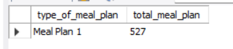
Query 2: Which meal plan is the most popular among guests?
select type_of_meal_plan,count(*) as total_meal_plan
from hotel_reservation
group by type_of_meal_plan
order by count(*) desc
limit 1;
Output:

Slide 10
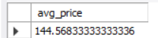
Query 3: What is the average price per room for reservations involving children?
select avg(avg_price_per_room), room_type_reserved
from hotel_reservation
where no_of_children>0
group by room_type_reserved
order by room_type_reserved asc;
Output:

Slide 11

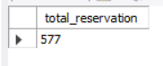
Query 4: How many reservations were made for the year 20XX (replace XX with the desired year)?
select count(*) as total_reservation
from hotel_reservation
where arrival_date like '%2018';
Output:

Slide 12

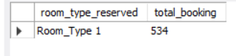
Query 5: What is the most commonly booked room type?
select room_type_reserved,count(*) as total_booking
from hotel_reservation
group by room_type_reserved
order by count(*) desc
limit 1;
Output:

Slide 13
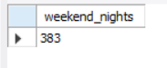
Query 6: How many reservations fall on a weekend (no_of_weekend_nights > 0)?
select count(*) as weekend_nights
from hotel_reservation
where no_of_weekend_nights > 0;
Output:

Slide 14

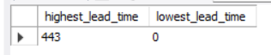
Query 7: What is the highest and lowest lead time for reservations?
select max(lead_time) as highest_lead_time,
min(lead_time) as lowest_lead_time
from hotel_reservation;
Output:

Slide 15
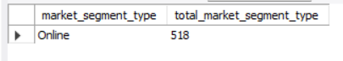
Query 8: What is the most common market segment type for reservations?
select market_segment_type,count(*) as total_market_segment_type
from hotel_reservation
group by market_segment_type
order by count(*) desc
limit 1;
Output:

Slide 16
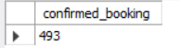
Query 9: How many reservations have a booking status of "Confirmed"?
select count(*) as confirmed_booking
from hotel_reservation
where booking_status = 'Not_Canceled';
Output:

Slide 17
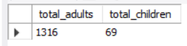
Query 10: What is the total number of adults and children across all reservations?
select sum(no_of_adults) as adults,
sum(no_of_children) as children,
room_type_reserved
from hotel_reservation
group by room_type_reserved
order by room_type_reserved asc;
Output:

Slide 18

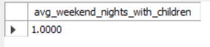
Query 11:What is the average number of weekend nights for reservations involving children?
select avg(no_of_weekend_nights) as avg_weekend_nights_with_children
from hotel_reservation
where no_of_children>0;
Output:

Slide 19
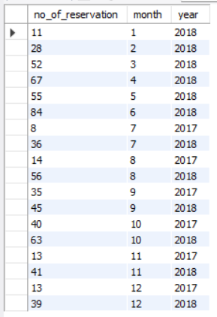
Query 12: How many reservations were made in each month of the year?
Output:
select count(*) as no_of_reservation,
month(str_to_date(arrival_date,'%d-%m-%Y')) as month,
year(str_to_date(arrival_date,'%d-%m-%Y')) as year
from hotel_reservation
group by month(str_to_date(arrival_date,'%d-%m-%Y')),
year(str_to_date(arrival_date,'%d-%m-%Y'))
order by month asc;

Slide 20
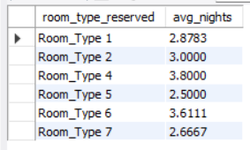
Query 13: What is the average number of nights (both weekend and weekday) spent by guests for each room type?
select room_type_reserved,
avg(no_of_weekend_nights + no_of_week_nights) as avg_nights
from hotel_reservation
group by room_type_reserved
order by room_type_reserved;
Output:

Slide 21
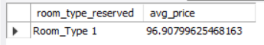
Query 14: For reservations involving children, what is the most common room type, and what is the average price for that room type?
select room_type_reserved,avg(avg_price_per_room) as avg_price
from hotel_reservation
group by room_type_reserved
order by count(*) desc
limit 1;
Output:

Slide 22
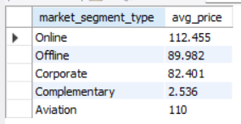
Query 15: Find the market segment type that generates the highest average price per room.
select market_segment_type,round(avg(avg_price_per_room),3) as avg_price
from hotel_reservation
group by market_segment_type
order by market_segment_type desc;
Output:

Slide 23


OVERALL INSIGHTS
There are 700 reservations in the dataset.
Meal plan 1 stands out as the most popular choice among guest.
Average price per room for reservation involving children is 145 approximately.
In 2018, there were 577 reservations.
Room type I is the preferred choice for bookings with 534 bookings.
383 reservations fall on the weekend.
The range of lead times from 0 to 443 days suggests diverse booking behaviors among guests. Some prefer last-minute reservation, while others plan well in advance.
The most common market segment type is online with 518 reservations.
493 out of 700 reservations are confirmed, indicating a 70.43% success rate.
Majority of reservation 1316 involve adult guests.
Reservations with children suggests a preference for averagely one-night stay on weekends.
The peak reservation month is October, while January records the lowest number of reservation.
Room type 4 guests prefer longer night stays (average of 3.80 nights), while Room type 5 guests opt for shorter durations.
For reservations involving children Room type I is the preferred choice with an average room price of 123.12.
Online bookings generated the highest average price per room reaching approximately 112.46.

Slide 24



CONCLUSION
The analysis of hotel reservations using SQL provides hotels with valuable insights that are essential for optimizing guest satisfaction and operational efficiency. These insights enable hotels to make informed decisions, such as adjusting pricing strategies, allocating resources more effectively, and improving service delivery. Ultimately, this analytical approach not only improves the overall guest satisfaction but also strengthens the hotel's competitive position in the market.

Slide 25


THANK
YOU

